Slide 1


Stredná odborná škola obchodu a služieb Samuela Jurkoviča, Sklenárova 1352/1, 821 09 Ružinov
Matúš Országh
Simon Šimko
Oliver Kubelka
Sebastian Špaček

Slide 2

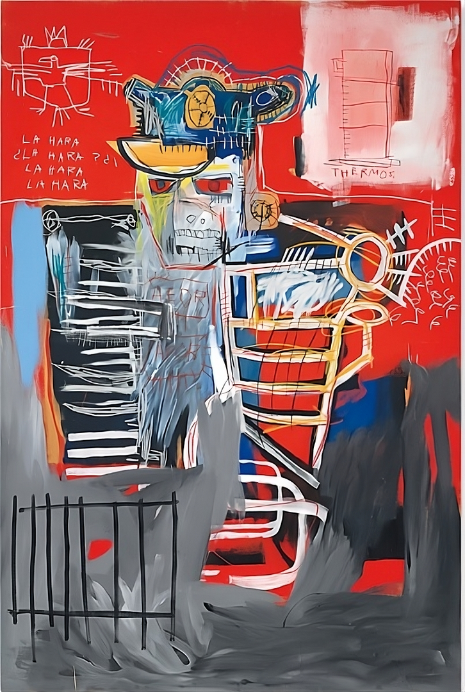
Prečo LA HARA?

Slide 3
Prečo tak politicky?

Slide 4
To tak chceli?

Slide 5
Inšpirácia

Slide 6
=
Fáza I
Buzz
Notes:
zaradenie publika
zdôraznenie charakteru
začiatok výroby
povedomie verejnosti
jasne zdôrazniť myšlienku a anti kapitalistické idei

Slide 7
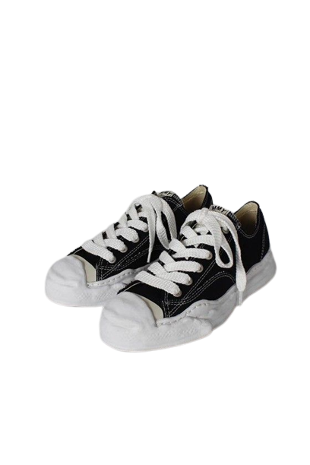
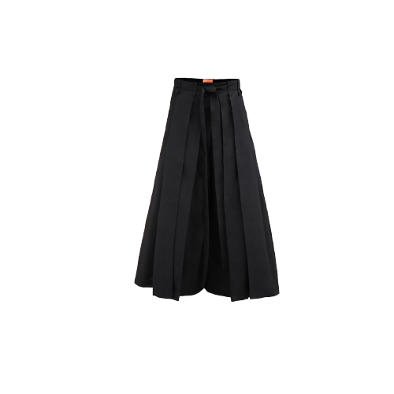

Slide 8
=
Fáza II
Stretch
Notes:
zachytiť spolupráce a pustiť do vnútra umenie
zdôrazniť najmä hudobne podklady a veľmi dôležité referencie, skryté hodnoty a správy
(vydávanie magazínu (katalógu)a spomenúť výrobu oblečenia)

Slide 9





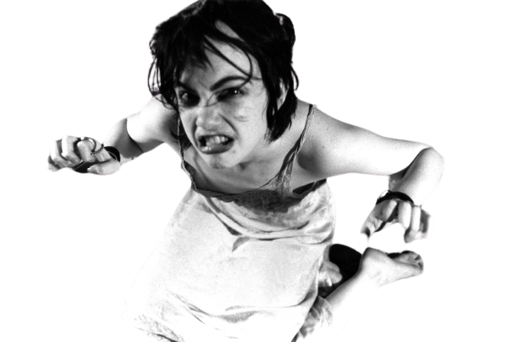
EDITORIAL
CONTENT
RADICAL ENOUGH?
PRODUCTS
PAGE 3
REVIEW:
PAGE 5
FAN FAVORITES
INSPIRATION
PAGE 8
LATEST POP-UP
NEWS
PAGE 9
HELLO FROM FIRST EPISODE
HELLO FROM FIRST EPISODE
WRITE TO US!!!
infolahara@gmail.com
instagram: @la_hara
WE CARE FOR THE PAPER
COVER: LUNG LEG
FROM MOVIE: SUBMIT TO ME
One day, as he was leaving the room, he said, "**** it," and decided he was too noble for greed and words of hate. It was well understood in the community that he would leave. So, as he went outside to eat, he got so full that he burst onto the table. When he tried to save himself, no one looked or helped. They were all busy eating their own meals, too tired to notice.
To save this era.
La Hara Team
LA HARA
PRIBINOVA 29
821 09 BRATISLAVA
+421 907 733 184
PUBLISHED MONTHLY
SUPPORTED BY OUR DEAREST OF FRIENDS
SUPPORTED BY OUR DEAREST OF FRIENDS
IMPORTANT PEOPLE
OLIVER KUBELKA
SIMON ŠIMKO
SEBASTIAN ŠPAČEK
MATÚŠ ORSZÁGH
VOLUME 1 NUMBER 1
SEPTEMBER 2023
FREE FOR ALL

Slide 10
=
Fáza III
Start
Notes:
prvý pop up store-
predstavenie oblečenia
(koncerty)

Slide 11
Budúcnosť

Slide 12
Ďakujeme za pozornosť

